Slide 1
Credit Risk System
Jeevan Shriram Arande
Raj Shukla

Slide 2
Objective
Development of a system for predicting credit risk of the customer based on customer credit history & attributes. The modal will determine whether a customer is having a good or bad credit risk.
Benefits:
Detection of Credit Risk of customer
Helps with mitigating risk of loan for customers

Slide 3
Data Sharing Agreement
SouthGermanCredit.csv
No date/time columns
No. of Columns: 21
Columns Names: status, duration, credit_history, purpose, amount, savings, employment_duration, installment_rate, personal_status_sex, other_debtors, present_residence, property, age, other_installment_plans, housing, number_credits, job, people_liable, telephone, foreign_worker, credit_risk
Data Types: All: Integer

Slide 4
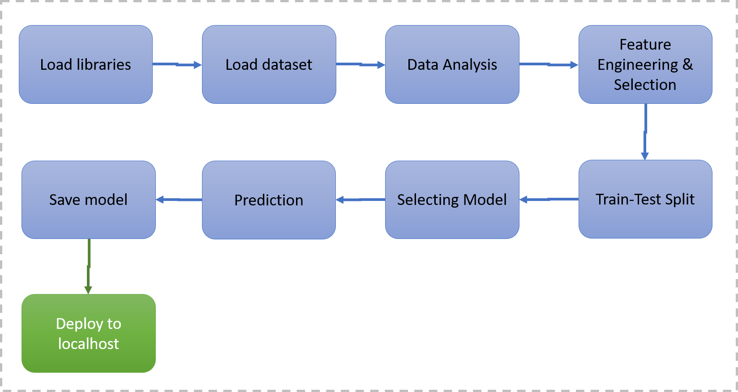
Architecture

Slide 5
Data Fetching
Data is stored in online Cassandra Database instance on Astra.
Python Scripts connects to database using Developer Credentials
Cassandra Database is selected and session is started
Table from Cassandra Database is selected and the query is written to fetch the data
Session is closed
The data from query is saved in CSV format for further steps

Slide 6
Model Training
Data Export from CSV file:
The Cassandra extracted data is loaded for model building
Feature Selection
ANOVA is used to select continuous columns
Chi Square Analysis for categorical columns
Data Preprocessing
Label Encoding of Ordinal columns
One Hot Encoding of Nominal Columns
Min Max Scaling of all the columns after encoding steps
Model Selection
After the data is split into Train, validation and test dataset. We find the best model by using multiple algorithms (Logistic, Decision Tree, Random Forest). The hyper tunned algorithms are used. We calculate the f1 score and select for all the models with best score.

Slide 7
Prediction
The data comes from the Bootstrap form created in the Flask App
The data is cleaned and loaded
We perform the data preprocessing techniques on it
Random Forest model created during training is loaded and the credit risk is predicted
The credit risk response is then passed to the request that came from the Bootstrap form.

Slide 8
Q&A
What’s the source of data?
The data for training come from a Cassandra database instatance from Astra Platform.
What was the type of data?
The data was the combination of numerical and categorical values
What’s the complete flow you followed in this Project?
Please refer to the slide 4.
How logs are managed?
Different steps have generating logs in different files. i.e. connect db, get data, load data, split data, train and evaluate

Slide 9
What techniques were you using for data preprocessing?
Removing unwanted attributes
Cleaning and imputing if null values are present
Encoding the ordinal (label) and nominal (one hot) columns
Scaling the data
How training was done or what models were used?
The data was split into Training, Validation and Test Set
The preprocessing steps were performed on all sets
Grid Search with Cross Validation was used for fitting the model and tuning the hyper-parameters
Model tested on were – Logistic Regression, Decision Tree, Naïve Bayes, Random Forest
How prediction is done?
The Bootstrap Form used to input the data
The data is sent to the flask where the preprocessing steps are performed
The fitted model is loaded and the prediction is made
The response (Credit Risk – Good or Bad) is then sent back.

